Slide 1
Previous Lecture
aquifer heterogeneity
layered systems
aquifer anisotropy
questions?
Notes:
1

Slide 2
Today
steady-state groundwater flow in three dimensions:
Darcy‘s law in isotropic aquifers
streamlines and flow nets
isochrones and protection zones
Darcy‘s law in anisotropic aquifers
Notes:
2

Slide 3
Darcy‘s Law in Isotropic Aquifers
Notes:
3

Slide 4
Hydraulic Head
Darcy‘s column experiment is associated with one-dimensional (1D) steady-state flow.
Hydraulic head h in a Darcy column therefore depends on a single space coordinate, say x, which is oriented along the column, i.e. h = h(x).
If steady-state flow is considered in a three-dimensional (3D) aquifer, hydraulic head is a function of three space coordinates, i.e. h = h(x,y,z).
Aquifers are frequently treated as two-dimensional (2D) systems. This is justified if vertical flow components are negligible as compared to horizontal flow components. The 2D approach often works as the horizontal extent of an aquifer is usually much larger than the thickness.
In many applications aquifers are represented by several layers and each of these layers is then treated as a 2D-system.
For the steady-state 2D case we have h = h(x,y) if vertical flow can be neglected.
In any case (1D or 2D or 3D), hydraulic head is the sum of hydrostatic pressure head and elevation head.
Notes:
4

Slide 5
Isolines and Isosurfaces
Isolines (isosurfaces) are curves (surfaces) where a physical quantity assumes a certain value.
2D problems: isolines
3D problems: isosurfaces
The representation of isolines yields a map. Isolines are therefore frequently superimposed on an already existing map.
The simultaneous representation of several isosurfaces is mostly confusing. In this case, 2D cross sections through isosurfaces are depicted.
Intervals between values represented by isolines (isosurfaces) are constant.
Notes:
5

Slide 6
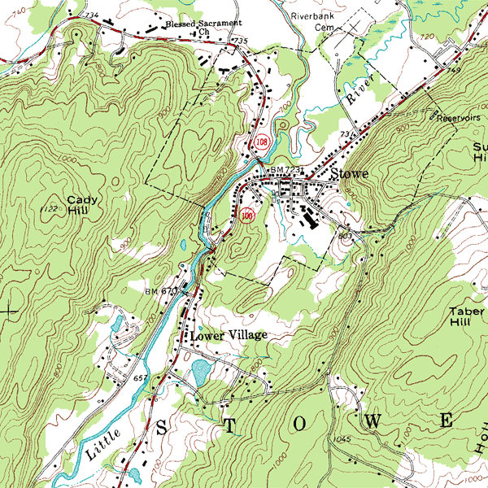
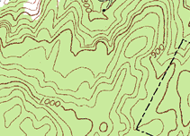
Example: Contours in a Topographic Map
Notes:
6

Slide 7
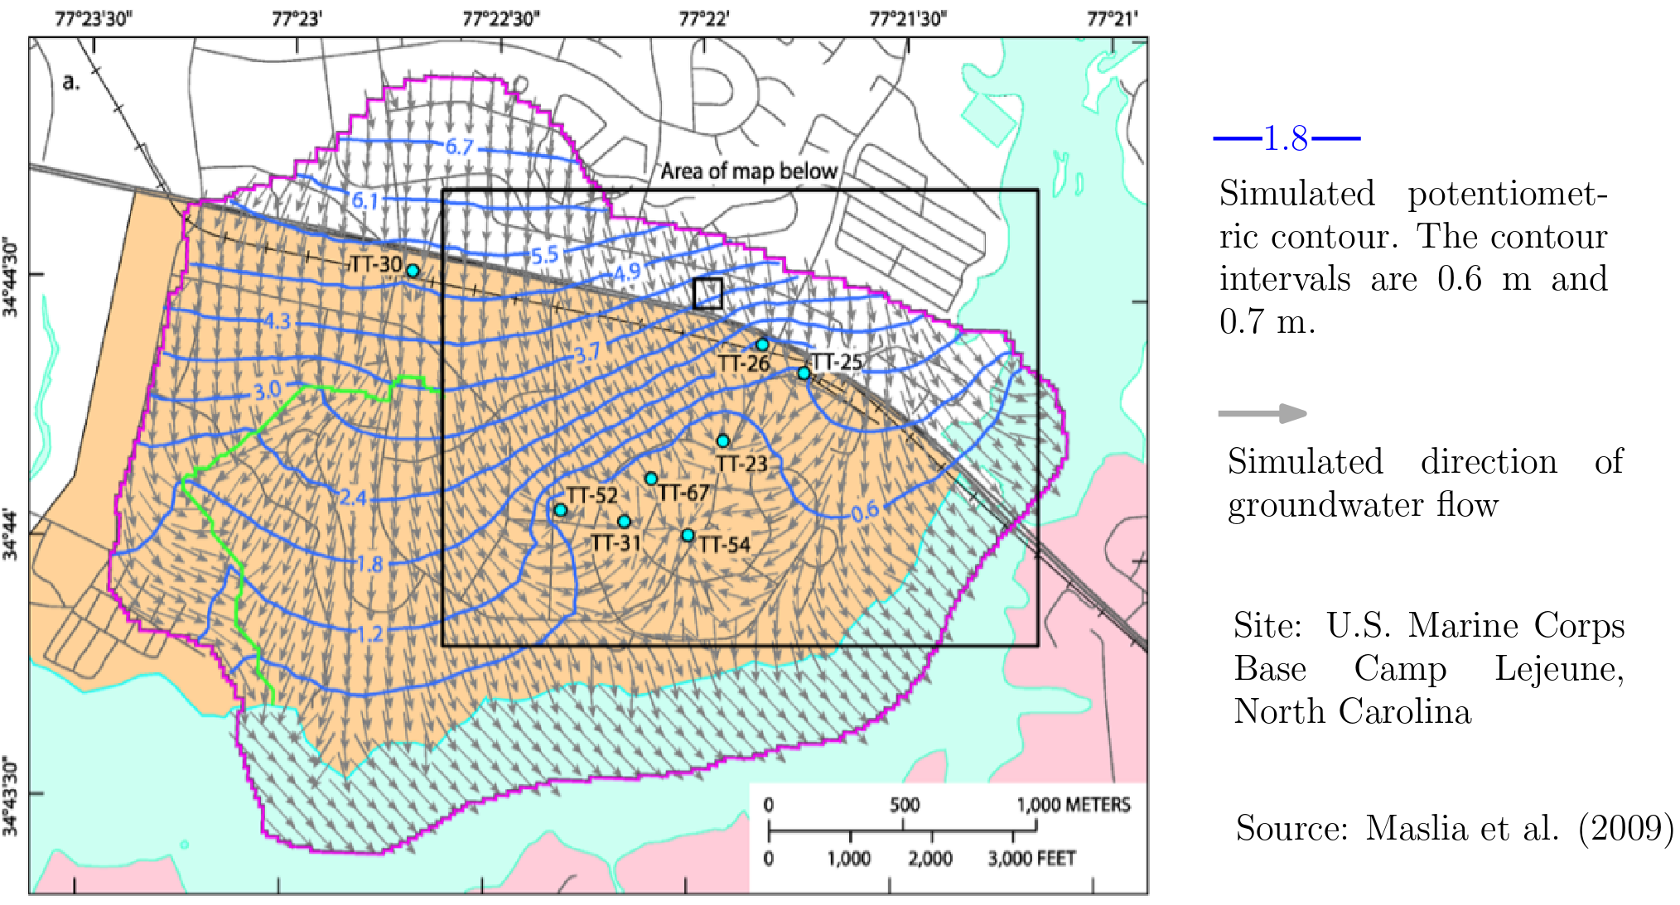
Example: Head Isolines from a 2D Groundwater Flow Model
Notes:
7

Slide 8
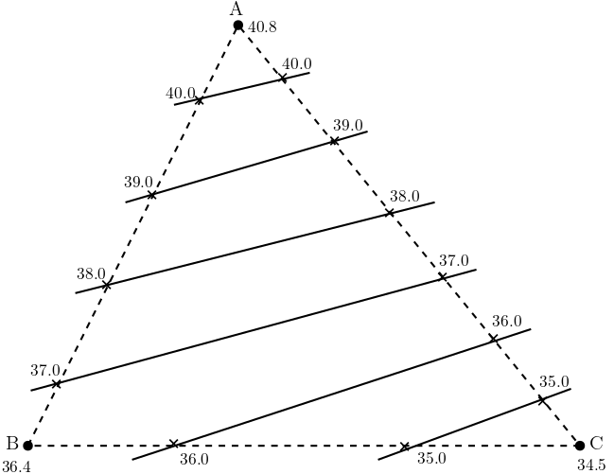
Hydrologic Triangle
If head values are available at some distinct locations only (observation wells), it is possible to approximate head isolines with the help of a hydrologic triangle.
This is done by connecting measure-ment locations with straight lines (da-shed lines in the figure) and then per-forming linear interpolation of heads along these lines for predefined head intervals (Δh = 1 m in the figure).
Finally, points with identical head valu-es are connected to obtain the isolines (solid lines in the figure).
Notes:
8

Slide 9
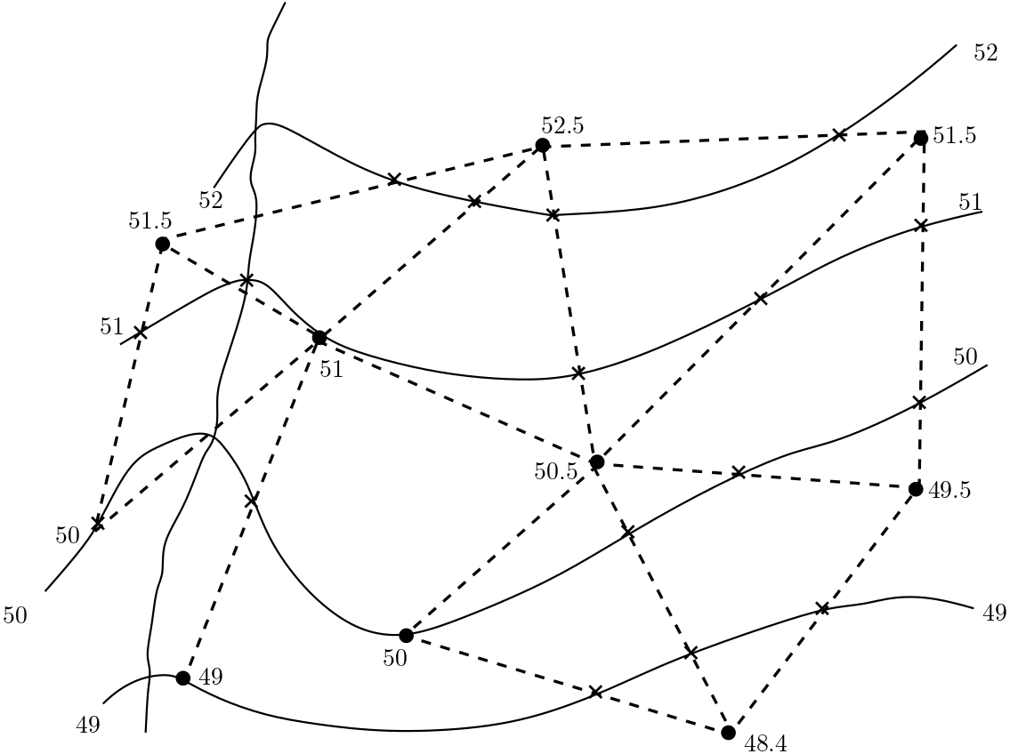
Applying the Hydrologic Triangle
In practical cases, more than just three observation points are available.
This implies a triangulation of the investigation area as shown in the figure.
Linear interpolation of heads is again performed along the dashed lines.
Points with identical head values are connected to obtain the isolines.
Connections can be straight line segments or “smooth“ curves as shown in the figure.
Notes:
9

Slide 10
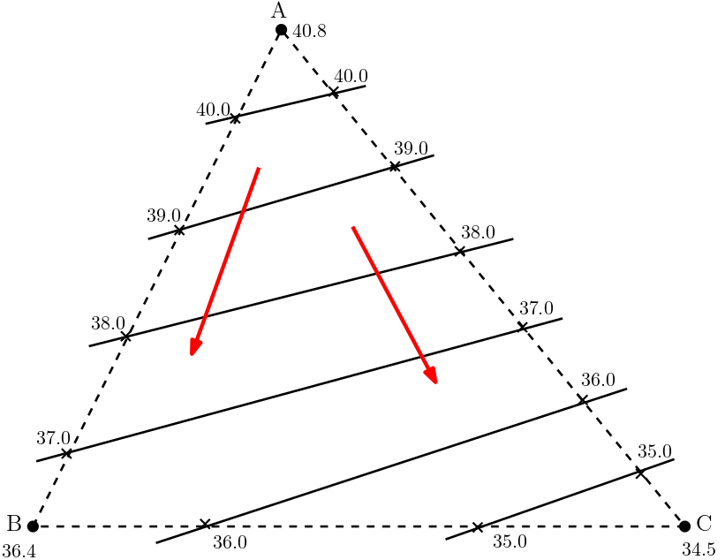
Flow Direction
From our knowledge about Darcy‘s law for 1D flow we may assume that 2D or 3D flow is also directed from regions with larger head values towards regions with smaller head values (red arrow in figure).
Question: What is the correct extension of Darcy‘s law?
Notes:
10

Slide 11
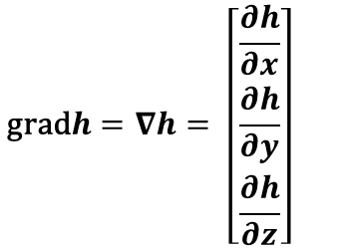
Hydraulic Gradient
The hydraulic gradient provides a major constituent of Darcy‘s law for 1D flow.
In the 1D case the hydraulic gradient is given as the ratio of head change vs. distance of flow.
For 2D or 3D flow the hydraulic gradient must be a vector quantity in order to combine magnitude and direction.
This is achieved by employing partial derivatives of hydraulic head with respect to Cartesian coordinates:
$$\text{grad}h=∇h= \left[\begin{matrix}\frac{∂h}{∂x} \\ \frac{∂h}{∂y} \\ \frac{∂h}{∂z}\end{matrix}\right]dg$$
gradh is a vector pointing in the direction of the steepest increase of h.
When hydrogeologists speak of the hydraulic gradient, they usually refer to the direction of steepest decrease of hydraulic head.
Notes:
11

Slide 12
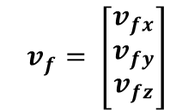
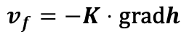
Darcy’s Law (Isotropic Aquifer)
For 2D or 3D flow the Darcy velocity v_{f} is a vector with two or three components, resp.
3D Darcy velocity vector:
$$dv_{f}= \left[\begin{matrix}v_{fx} \\ v_{fy} \\ v_{fz}\end{matrix}\right]$$
Darcy‘s law relates the Darcy velocity and the hydraulic gradient via
$$v_{f}=−K⋅\text{grad}h$$
heterogeneous aquifer: K = K(x,y,z)
homogeneous aquifer: K = const.
For isotropic aquifers the Darcy velocity vector is oriented opposite to the hydraulic gradient vector (due to the minus sign in Darcy‘s law).
Notes:
12

Slide 13
Darcy Velocities
Notes:
13

Slide 14
Streamlines and Flow Nets
Notes:
14

Slide 15
Basics
Streamlines or flowlines are curves which are in each point tangential to the flow direction.
There is no flow component perpendicular to the streamlines.
As a consequence, streamlines are perpendicular to head isosurfaces or head isolines if the aquifer is isotropic.
Flow nets consist of a set of isosurfaces (or isolines) and a set of streamlines.
Flow nets are usually employed for 2D flow scenarios only. The flow behaviour is illustrated by covering the investigation area with a mesh of isolines and streamlines.
Notes:
15

Slide 16
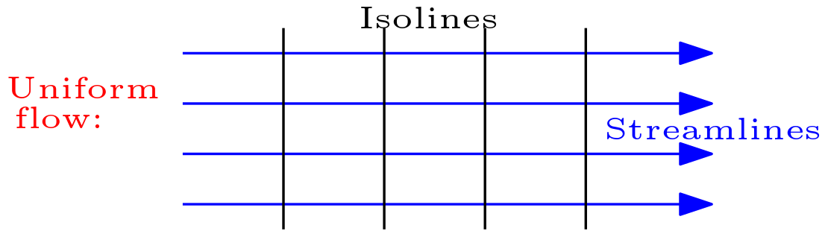
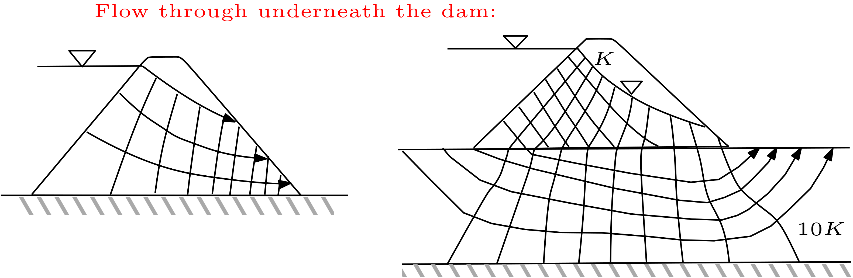
Examples
(Freeze and Cherry, 1979)
Notes:
16

Slide 17
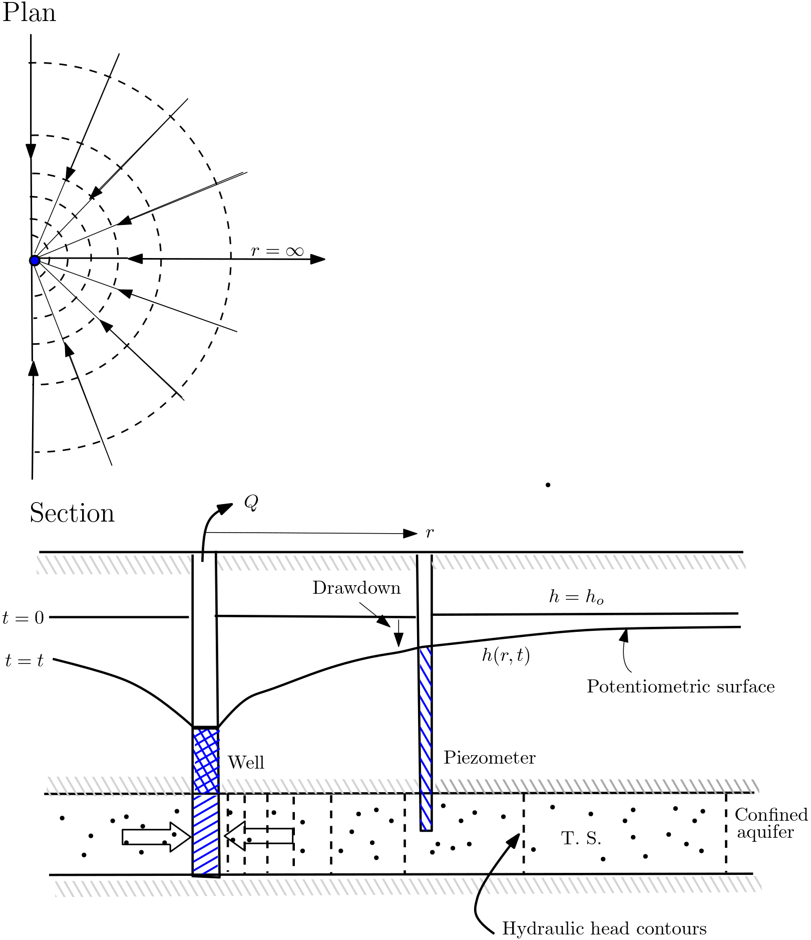
Radial Flow Near a Well
In this example steady-state water abstraction from a pumping well, e.g. for drinking water supply, is considered.
The hydraulic conductivity is assu-med to be spatially constant (homogeneous aquifer).
If there are no further hydraulic im-pacts, pumping leads to a radially symmetric drawdown of hydraulic heads.
Streamlines radially approach the pumping well.
Head isolines are circles with the well in the centre.
streamline
isoline
(Freeze and Cherry, 1979)
Notes:
17

Slide 18
Superposition of Uniform and Radial Flow
uniform
flow
well
streamline
stag-
nation
point
isoline
The dividing streamline (solid black line) represents the boundary of the well capture zone.
Flow velocities of the uniform flow and the radial flow exactly compensate each other at the stagnation point. The resulting flow velocity equals zero.
Notes:
18

Slide 19
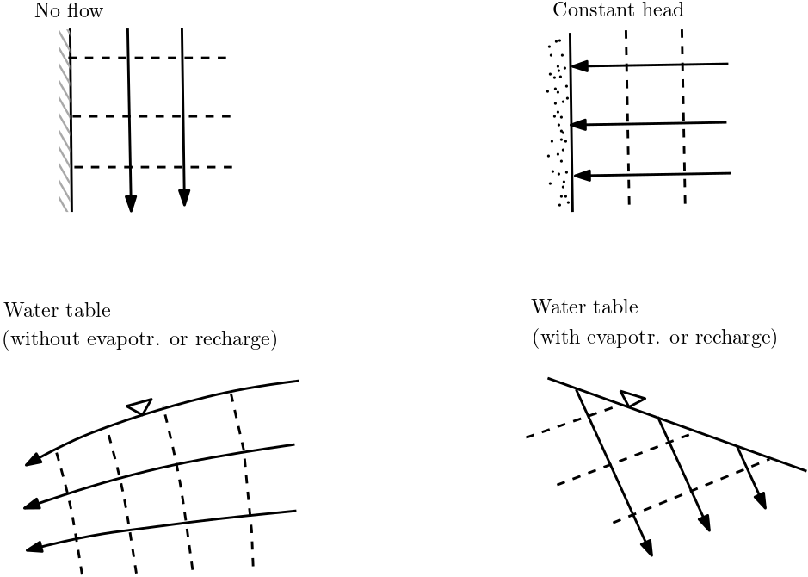
Some Rules for Drawing Flow Nets
Drawing a flow net for a certain domain requires information about domain boundaries.
Impermeable boundaries represent a streamline.
Boundaries with given constant head values represent isolines.
Symmetries in domain geometry and conditions at boundaries result in symmetric flow nets.
Isolines and streamlines are drawn only for the saturated zone, i.e. they do not cross the water table.
Isolines do not intersect each other. Streamlines do not intersect each other.
Streamlines are never closed (“circular“). They start at an inflow boundary and end at an outflow boundary.
Adjacent isolines and streamlines should form “curvilinear squares“.
Notes:
19
Psi, rho*g = unit weight

Slide 20
Isochrones and Protection Zones
Notes:
20

Slide 21
Isochrones
uniform & radial
streamline
uniform
flow
isochrone
Isochrones are curves of identical travel times.
Isochrones and streamlines do not necessarily intersect each other at an angle of 90°!
Isochrones are needed to delineate water protection zones.
Notes:
21

Slide 22
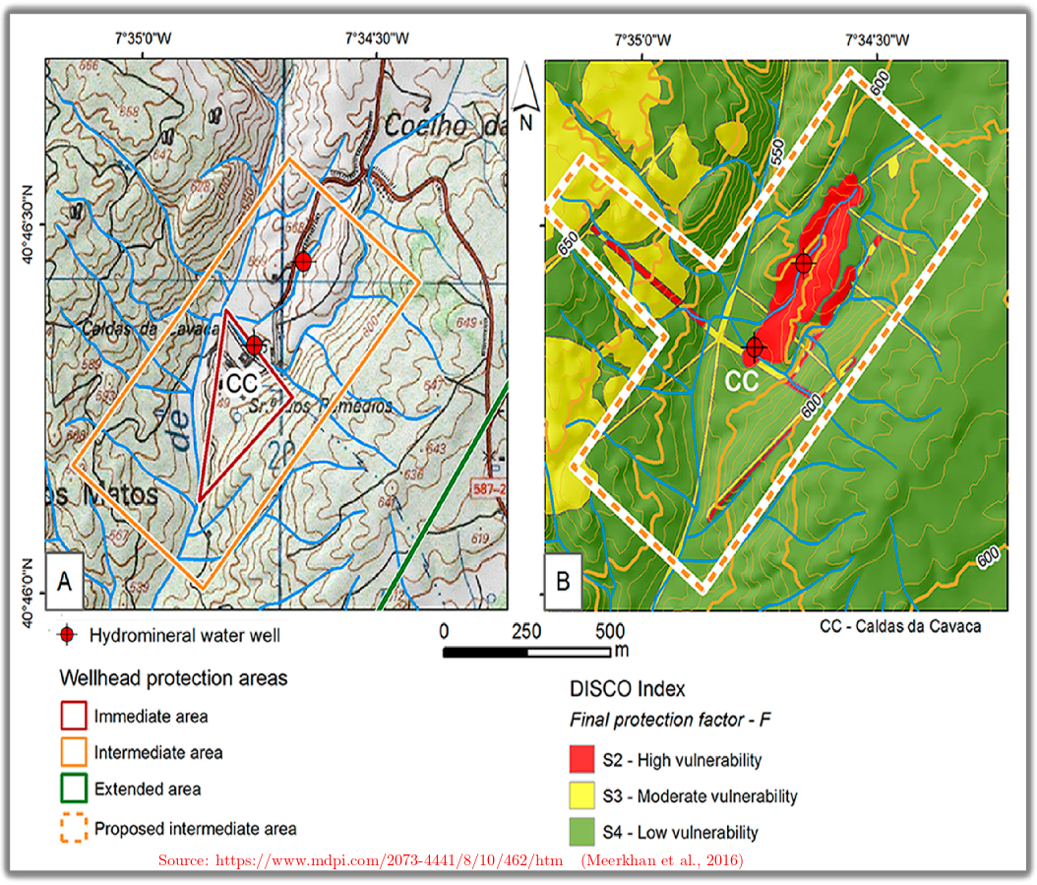
Examples of Protection Zones
According to German regulations, well capture zones are subdivided in three protection zones.
The boundary of protection zone II has to be on or outside of the 50-days isochrone.
Here, protection zone II is shown in red for several well fields.
This implies that water needs at least 50 d to travel from the edges of the red areas to the abstraction wells.
The edge of the orange/yellow area represents the boundaries of the well field capture zone (dividing streamli-nes).
Notes:
22

Slide 23
Well Capture Zones in Heterogeneous Aquifers
Notes:
23

Slide 24
Darcy‘s Law in Anisotropic Aquifers

Slide 25
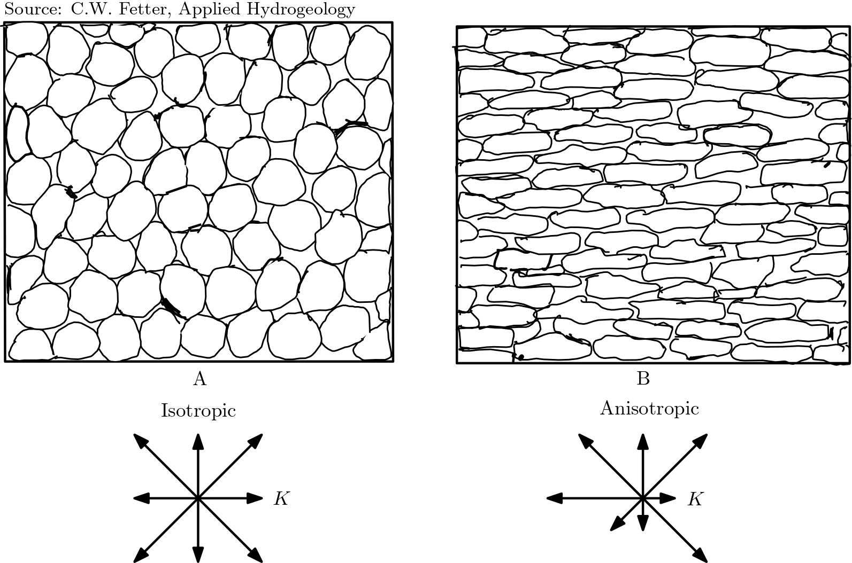
Principal Axes of Hydraulic
Conductivity
In anisotropic aquifers there is a di-rection with maximum hydraulic conductivity and another direction with minimum hydraulic conductivity.
It was found that these two directions are perpendicular to each other. (This is true in general, not only for the layered systems covered in the previous lecture.)
The three principal axes of hydraulic conducitivity are oriented
– along the direction with maximum hydraulic conductivity, – along the direction with minimum hydraulic conductivity, – perpendicular to both.

Slide 26
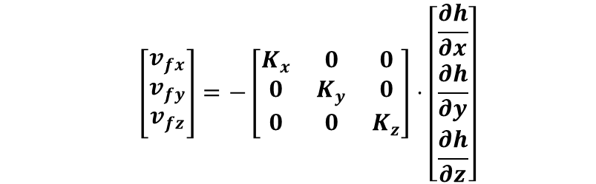
Formulations of Darcy’s Law in Anisotropic Aquifers I
If the principal axes of conductivity coincide with the axes of a Cartesian coordinate system, Darcy‘s law for anisotropic aquifers is given by
$$d\left[\begin{matrix}v_{fx} \\ v_{fy} \\ v_{fz}\end{matrix}\right]=−\left[\begin{matrix}K_{x} & 0 & 0 \\ 0 & K_{y} & 0 \\ 0 & 0 & K_{z}\end{matrix}\right]⋅\left[\begin{matrix}\frac{∂h}{∂x} \\ \frac{∂h}{∂y} \\ \frac{∂h}{∂z}\end{matrix}\right]$$
In this equation, hydraulic conductivity has to be written as a matrix.
To be more precise, K represents a tensor, i.e. a quantity which is subject to certain rules under coordinate transforms (from Cartesian to cylinder coordinates, for instance). These rules guarantee that Darcy‘s law can also be applied in coordinate systems other than Cartesian.

Slide 27
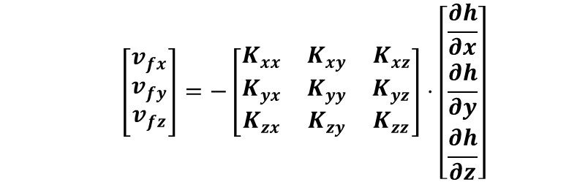
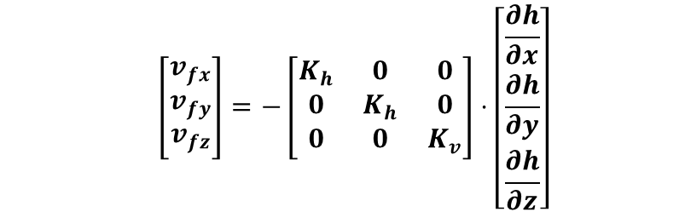
Formulations of Darcy’s Law in Anisotropic Aquifers II
If the aquifer is isotropic in the (horizontally oriented) xy-plane, we have
$$d\left[\begin{matrix}v_{fx} \\ v_{fy} \\ v_{fz}\end{matrix}\right]=−\left[\begin{matrix}K_{h} & 0 & 0 \\ 0 & K_{h} & 0 \\ 0 & 0 & K_{v}\end{matrix}\right]⋅\left[\begin{matrix}\frac{∂h}{∂x} \\ \frac{∂h}{∂y} \\ \frac{∂h}{∂z}\end{matrix}\right]$$
The most general case is encountered when all principal axes are associated with different hydraulic conductivities and none of them coincides with a coordinate axis:
$$d\left[\begin{matrix}v_{fx} \\ v_{fy} \\ v_{fz}\end{matrix}\right]=−\left[\begin{matrix}K_{xx} & K_{xy} & K_{xz} \\ K_{yx} & K_{yy} & K_{yz} \\ K_{zx} & K_{zy} & K_{zz}\end{matrix}\right]⋅\left[\begin{matrix}\frac{∂h}{∂x} \\ \frac{∂h}{∂y} \\ \frac{∂h}{∂z}\end{matrix}\right]$$
From this one may easily conclude that it is advantageous to arrange coordinate axes in parallel with prinipal axes of K. Unfortunately, this is not always possible, e.g. when layers are folded.

Slide 28
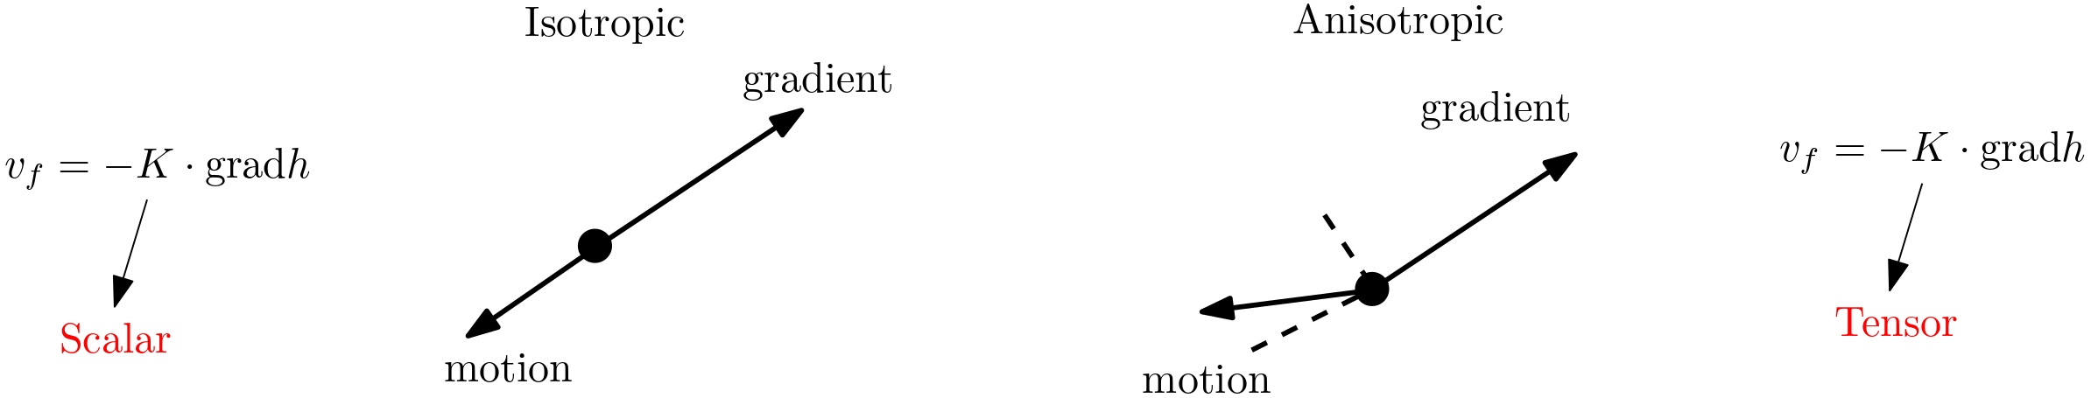
Direction of Flow
Isotropic aquifer: K can be represented by a scalar and the direction of flow is opposite to the direction of the gradient.
Anisotropic aquifer: K has to be represented by a tensor (matrix) and the angle between the gradient vector and the flow direction is between 90° and 180°.

Slide 29
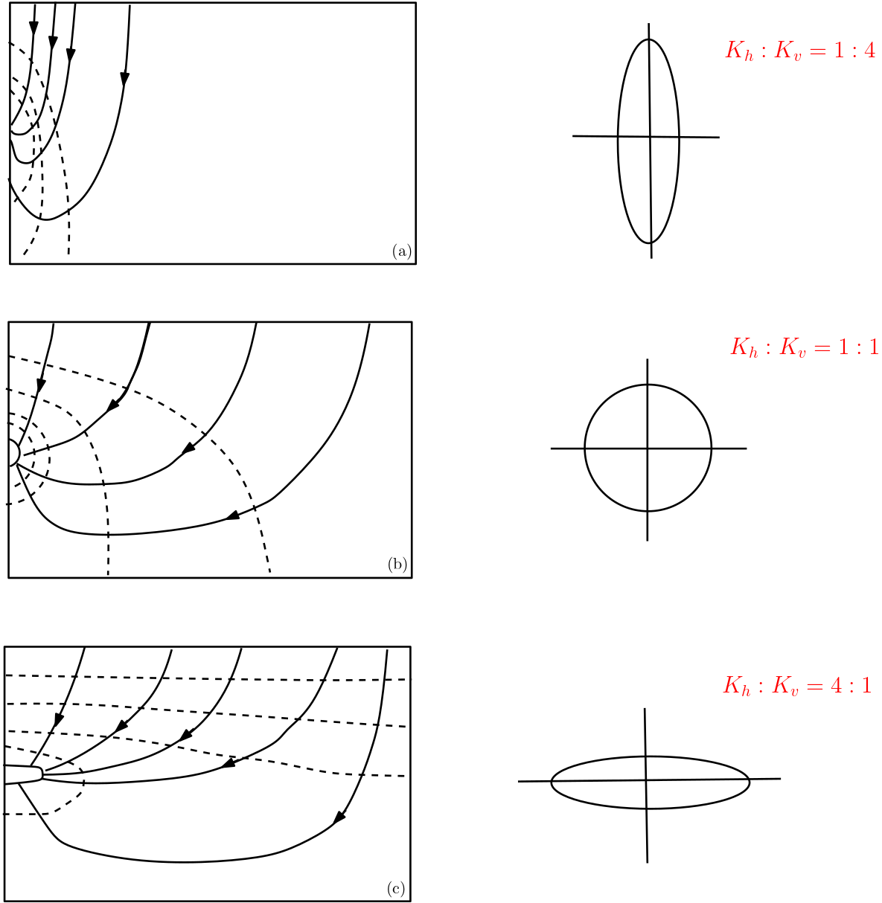
Examples for Flow Nets in Anisotropic Aquifers
The figure provides flow nets for different ratios of aniso-tropy but identical conditions at domain boundaries (inflow from the top, outflow to a pi-pe on the left).
Isolines and streamlines intersect each other at right angles only if the aquifer is isotropic.
aniso-tropic 2D

Slide 30

Quick check what we have understood?
Pls. scan the QR- code
or
click link the link:
https://partici.fi/11256520

